Slide 1
Irish Migrants in 19th-Century Britain (1750-1900)
www.ourmigrationstory.org.uk

Slide 2
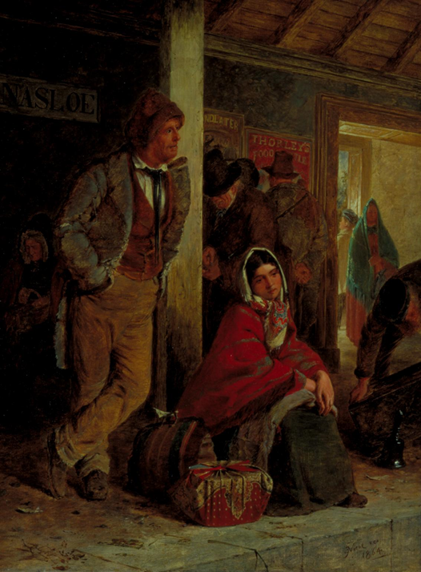
Lesson Objectives
Starter task
To know how the relationship between Ireland and Great Britain changed in 1800
To describe two representations of 19th century Irish migrants to Britain
To assess how far you agree with these representations
How are Irish migrants represented in Erskine Nicol’s painting ‘The Emigrants’?
What kind of response do you think the artist intended people viewing this painting to have towards Irish migrants?
How do you know?
www.ourmigrationstory.org.uk
Notes:
Starter task: This can be used as a way into discussing what is meant by a ‘representation’ for later in the lesson – what does it mean and how are they constructed? (Note: The picture is reproduced for clarity/printing as a handout on the following slide.)

Slide 3
Irish migrants in the 19th century
How are Irish migrants represented in Erskine Nicol’s painting ‘The Emigrants’?
What kind of response do you think the artist intended people viewing this painting to have towards Irish migrants?
How do you know?
'The Emigrants' by Erskine Nicol, 1864. This picture shows Irish emigrants at Ballinasloe station on their way to Galway to board boats to America.

Slide 4
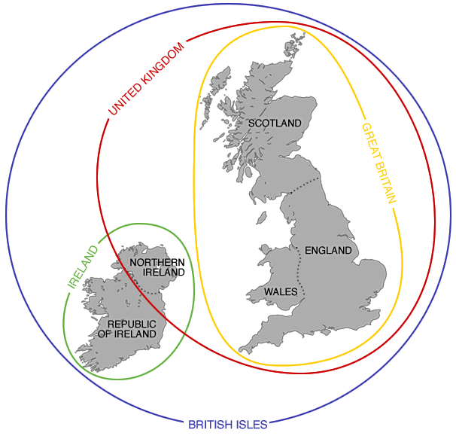
Great Britain vs the United Kingdom vs The British Isles
From 1542 until 1800, Ireland shared a monarch with England (and from 1603, Scotland), but had its own parliament.
From 1800 until 1922 the red line on the map would have incorporated the whole of the island of Ireland, as its parliament was abolished and it became a part of the United Kingdom of Great Britain and Ireland.
In 1922, the island of Ireland was partitioned, with Northern Ireland remaining part of the United Kingdom (now the United Kingdom of Great Britain and Northern Ireland) and the Irish Free State (now known as the Republic of Ireland) becoming independent.
Venn Diagram Map created by Anna Debenham, found at http://brilliantmaps.com/eng-gb-uk/
Notes:
This slide can be used after the video (see slide 5) but before the pupils answer the questions to explain the relationships between the various parts of the British Isles and how they have changed over time.

Slide 5
Questions based on Professor David Feldman – Migration to Britain 1750–1900
Irish migrants in the 19th century
How many Irish immigrants moved to other parts of the United Kingdom (England, Scotland and Wales) during the 19th century?
How did Ireland’s relationship with Great Britain change in 1800?
How did this potentially change the status of Irish people moving to Great Britain?
www.ourmigrationstory.org.uk
Notes:
Simple questions to meet learning objective 1 that gives pupils good context for the following activities on representations. Emphasise that although technically internal migrants, 19th century Irish immigrants to Britain (England, Scotland and Wales) were normally perceived as ‘foreign’. (Note: hyperlink to video in title)

Slide 6
Irish migrants in the 19th century
George Cornewall Lewis’s survey of the Irish community, 1836
George Cornewall Lewis’s survey of the Irish community, published in 1836, presented the findings of his whistle-stop tour of the hotspots of Irish settlement in Britain. The report was a sub-element of Archbishop Whateley’s huge investigation of poverty in Ireland and formed an appendix to the report of the Commission of Investigation into Irish Poverty.
The Commission of Investigation into Irish Poverty was put in place by the government of the day to check the need for an Irish Poor Law to match that which had been introduced in England (the Poor Law Amendment Act, 1834).
www.ourmigrationstory.org.uk
Notes:
This gives background on the source extracts used as sources A and B in the following activity – this is taken from the Our Migration Story website, which could be accessed and read by pupils if lesson is delivered in an ICT room

Slide 7
Irish migrants in the 19th century
Source A
How is the Irish immigrant community represented in this extract?
www.ourmigrationstory.org.uk

Slide 8
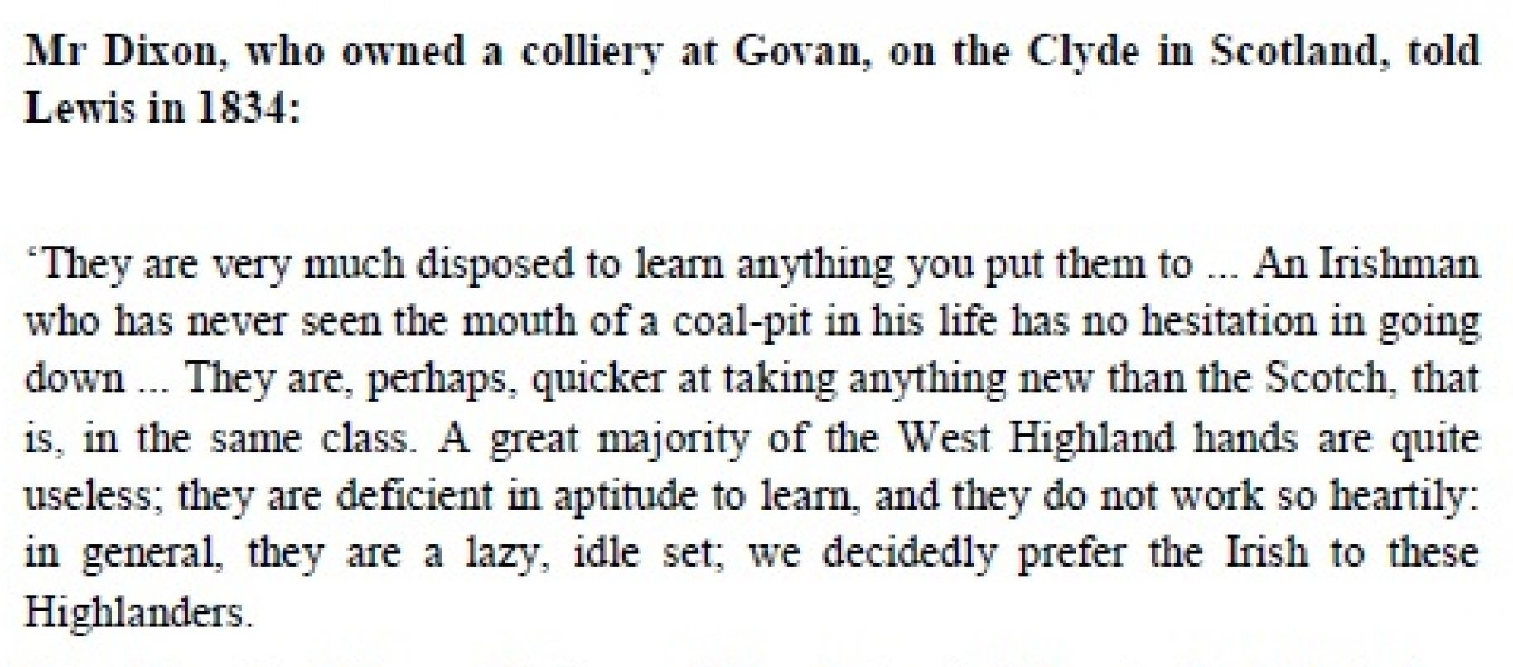
Irish migrants in the 19th century
Source B
How is the Irish immigrant community represented in this extract?
www.ourmigrationstory.org.uk

Slide 9
Which representation of Irish migrants in Britain is more accurate?
Representation of the Irish in each source | Source A | Source B
How accurate is this representation?
Which representation is more accurate and why?
Notes:
Labels to fill in table on previous slide – all/some can be given in this structured way (or less structured) to make the task easier. Or table could be done as a matching exercise.

